Slide 1
Managing Kernel Modules
Explore the Linux Kernel
Install and Configure Kernel Modules
Monitor Kernel Modules

Slide 2
Kernel (Slide 1 of 2)
The core component of an operating system.
All other components rely on it.
Manages file system access, memory, processes, devices, etc.
Controls all plugged-in hardware devices.
One of first elements to be loaded on startup.
Remains in memory during computer's operation.
Contains system-level commands/functions hidden from users.

Slide 3
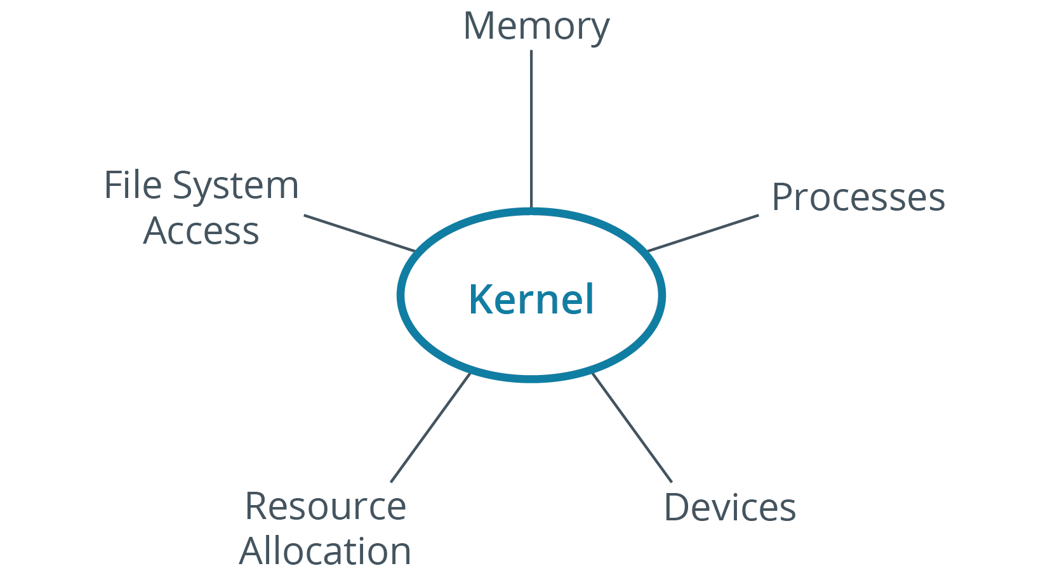
Kernel (Slide 2 of 2)

Slide 4
Kernel Space and User Space (Slide 1 of 2)
Kernel space:
Region in memory where kernel executes its services.
User space:
Region in memory outside of kernel space.
Includes high-level apps, background processes, system libraries, etc.
Software in user space accesses kernel space services.
Issues system calls.
Provides app with resources needed to perform a task.
Example: App calls kernel to leverage I/O for data storage writing.
Split between spaces promotes stability and security.

Slide 5
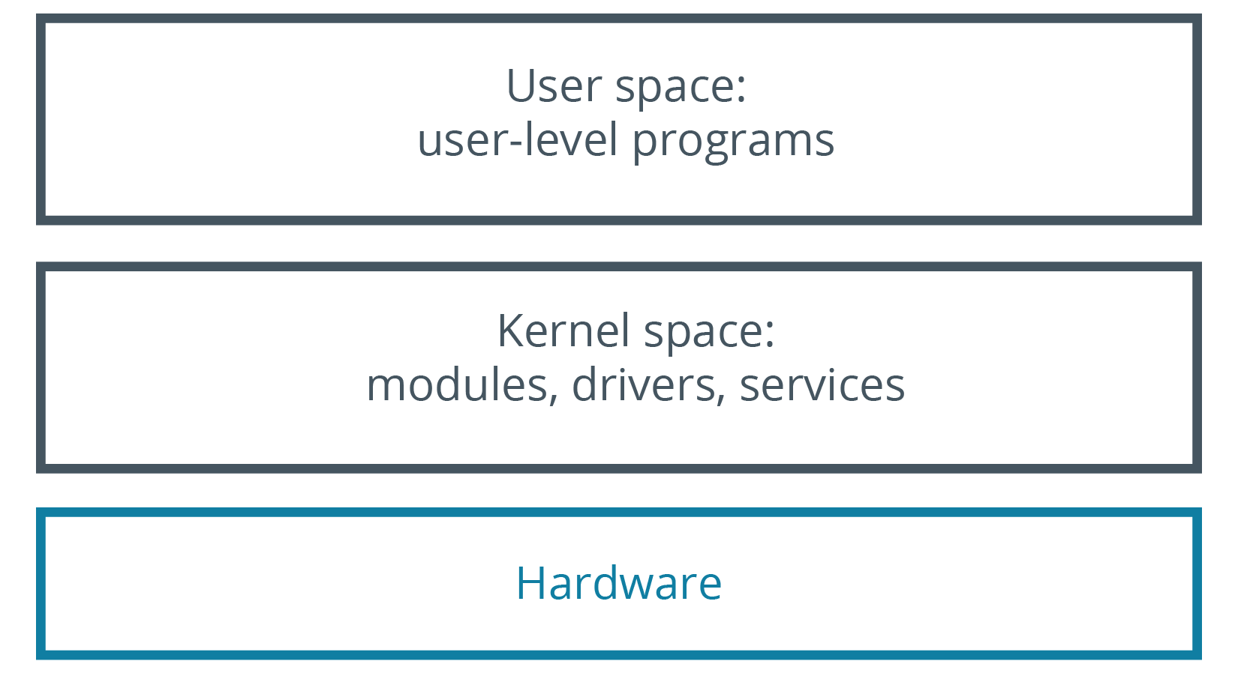
Kernel Space and User Space (Slide 2 of 2)

Slide 6
Types of Kernels
Monolithic:
All system modules run in kernel space.
Can interact quickly with devices.
Large size, consumes more RAM.
Less stable.
Microkernel:
Runs minimum resources necessary.
Smaller kernel space, larger user space.
Smaller over size, consumes less RAM.
More stable.
Worse performance.

Slide 7
The Linux Kernel
A free and open source monolithic kernel that manages all other resources on the operating system.
Device drivers run within kernel space.
Have full access to hardware.
Architecture provides many useful features.
Virtual memory, TCP/IP networking, shared libraries, etc.
Kernel is modular.
Users can configure/extend kernel functionality.
Each update is given a version number.
Format: major.minor
4.19 released in 10/2018.

Slide 8
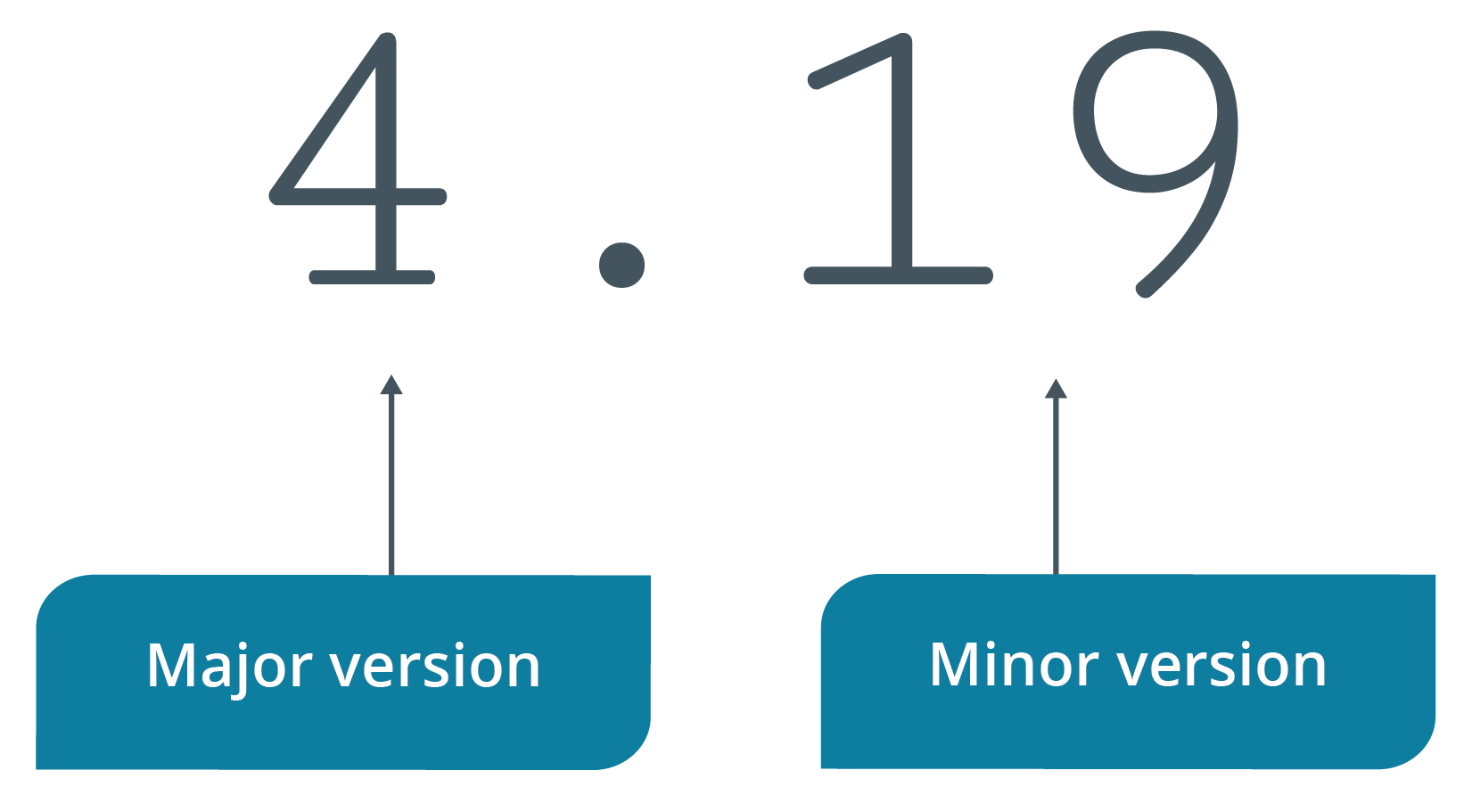
Kernel Versioning

Slide 9
The uname Command (Slide 1 of 2)
Prints name of kernel.
uname -r prints kernel version.
uname -i prints hardware platform.
uname -a prints all.

Slide 10
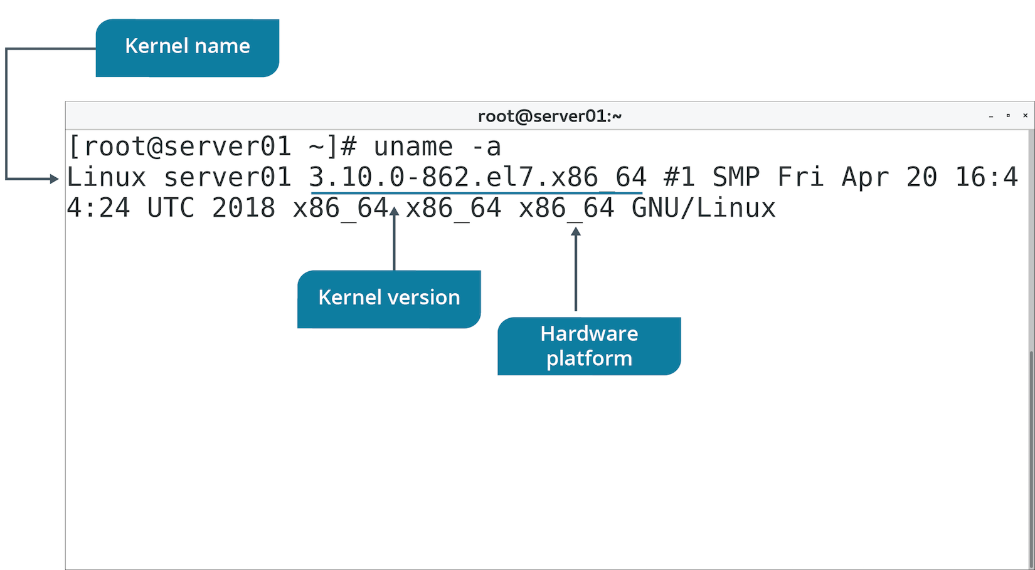
The uname Command (Slide 2 of 2)

Slide 11
Kernel Layers
Kernel Layer | Function
SCI | Handles system calls sent from user space to kernel. Enables scheduling of calls and of managing multiple calls at once.
Process management | Allocates execution space on processor to processes. Shares processor time for multiple processes.
Memory management | Shares memory with user space resources. Allocates memory on request and frees it when no longer needed.
File system management | Stores, organizes, and tracks files. Also supports VFS.
Device management | Manages interface between devices and user space. Reads calls to devices and passes them on.

Slide 12
Discussing the Linux Kernel

Slide 13
Activity: Exploring the Linux Kernel
You may need to troubleshoot kernel issues.
You'll explore kernel concepts to refresh your knowledge.

Slide 14
Kernel Modules
System-level objects that extend the functionality of the kernel.
Can be dynamically loaded/unloaded.
Kernel can recompile itself with a reboot.
Advantages:
Reduce burden on kernel.
Dynamic loading reduces memory consumption.
Avoid reboot when new functionality is required.
Use .ko extension.
Module for one kernel version may not be compatible with other versions.

Slide 15
The /usr/lib/ Directory
Contains shared libraries and binaries for software packages.
Not meant to be executed by users.
/usr/lib/modules contains modules for different kernel versions.
Has directory named after kernel's version number.
Modules are in subdirectories based on category.
Example Bluetooth driver module location:
/usr/lib/modules/<kernel version>/kernel/drivers/bluetooth/

Slide 16
Kernel Module Management Commands
Command | Used To
lsmod | Display loaded kernel modules and their details.
modinfo | Display info about a particular module.
insmod | Install module into running kernel. Doesn't install dependencies.
rmmod | Remove module from running kernel.

Slide 17
The modprobe Command
Used to add/remove modules from kernel.
Can load dependent modules as well.
Preferred over insmod and rmmod commands.
Use -a option to add modules.
Use -r option to remove modules.

Slide 18
The depmod Command
modprobe reads modules.dep to identify dependencies.
Needs this to be accurate.
depmod command updates modules.dep database.
Searches contents of /lib/modules/<kernel version>/ for each module.
Modules may export "symbols" (services).
Other modules may use exported symbols.
depmod aggregates instances of symbol export/use.
Builds modules.dep this way.

Slide 19
Kernel Module Configuration (Slide 1 of 2)
/etc/modprobe.conf
Configuration file whose settings apply to loaded modules persistently.
Can configure module dependencies and aliases.
Deprecated in newer distros.
/etc/modprobe.d/
Contains .conf files.
Files tell modprobe to run additional modules with specified options.
Chosen module leverages additional module's functionality.
Additional module not loaded into kernel.
Module might run better with other modules installed, but not loaded into kernel.

Slide 20
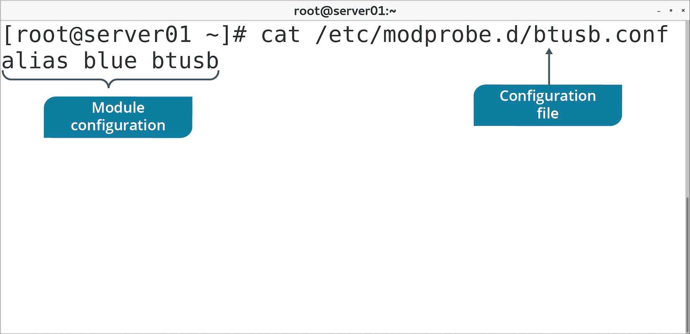
Kernel Module Configuration (Slide 2 of 2)

Slide 21
Kernel Parameters
You can change system parameters at runtime.
Improve performance, harden security, limit networking, etc.
/proc/sys/ lists configurable parameters.
Directory | Includes Parameters Related To
crypto | Cryptographic services.
debug | Debugging kernel.
dev | Hardware devices.
fs | File system data.
kernel | Miscellaneous kernel functionality.
net | Networking functionality.
user | User space limitations.
vm | Virtual memory management.

Slide 22
The sysctl Command (Slide 1 of 2)
Used to view or set kernel parameters at runtime.
Option | Used To
-a | Display all parameters and their values.
-w {parameter}={value} | Set a parameter value.
-p[file name] | Load settings from specified file.
-e | Ignore errors about unknown keys.
-r {pattern} | Apply command to parameters matching a pattern.

Slide 23
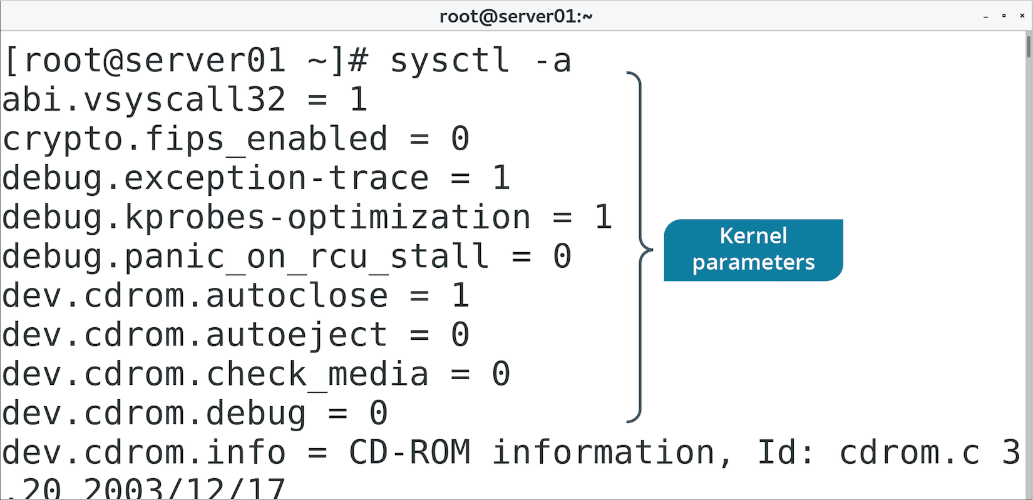
The sysctl Command (Slide 2 of 2)

Slide 24
Discussing Installing and Configuring Kernel Modules

Slide 25
Activity: Installing and Configuring Kernel Modules
You want to transfer data to your mobile device wirelessly.
You plug in a USB Bluetooth adapter.
The adapter doesn't seem to work.
You discover the USB Bluetooth driver isn't available.
You'll inspect the kernel and load the appropriate module.

Slide 26
The /proc/ Directory
File | Contains
/proc/cmdline | Options passed to kernel at boot time.
/proc/cpuinfo | CPU information.
/proc/devices | List of character and block devices loaded into kernel.
/proc/filesystems | List of supported file system types and any currently mounted.
/proc/meminfo | Information about RAM usage.
/proc/modules | Information about currently installed modules.
/proc/stat | Various stats about system since last reboot.

Slide 27
The /proc/version File (Slide 1 of 2)
Specifies info about kernel:
Version of kernel.
Version of GCC.
User name of compiler.
Time of compilation.
Version may impact system functionality.

Slide 28
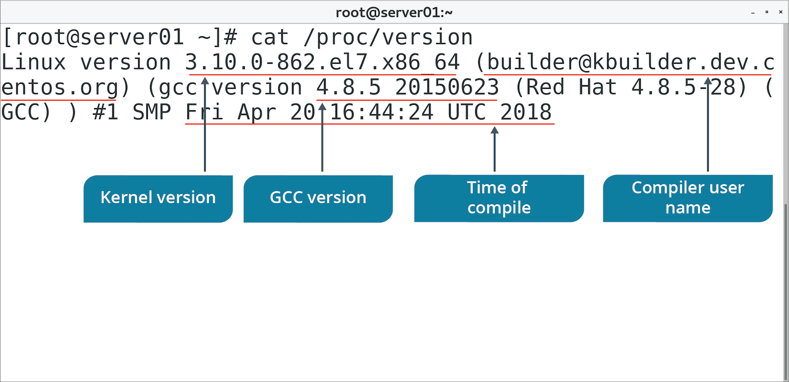
The /proc/version File (Slide 2 of 2)

Slide 29
The dmesg Command (Slide 1 of 2)
Prints messages sent to kernel buffer during and after boot.
Device drivers send messages.
Indicates status of modules/parameters.
Diagnostic messages when there are errors.
Other kernel components can send messages too.
Message buffer can also be accessed from /var/log/dmesg
Use to look for potential issues with kernel components.
Use to validate modules are loading.

Slide 30
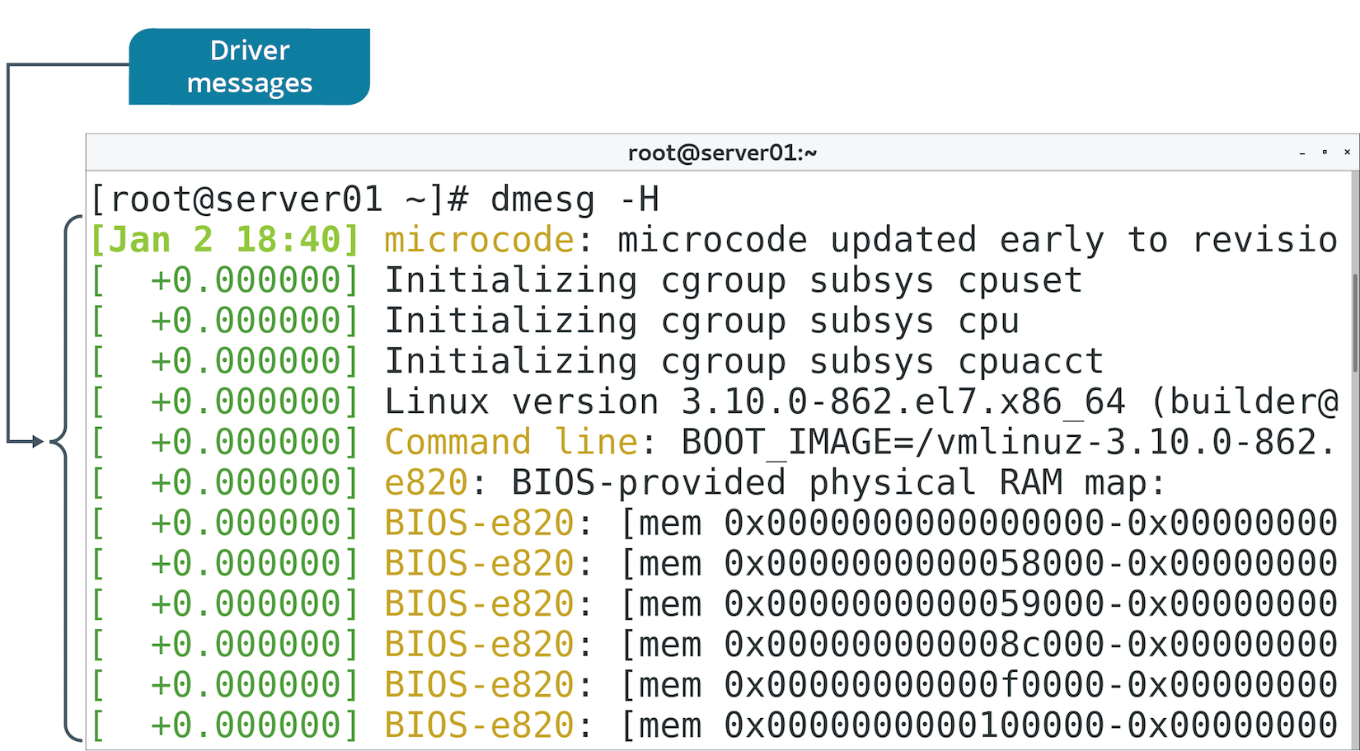
The dmesg Command (Slide 2 of 2)

Slide 31
Discussing Monitoring Kernel Modules

Slide 32
Activity: Monitoring Kernel Modules
You want to ensure USB Bluetooth module was loaded into kernel.
You want to ensure there aren't any errors.
Also identify kernel version for future reference.

Slide 33
Do you expect that you will need to load any special modules into the kernel to fulfill your organization's requirements? If so, what modules might you need to load?
Do you expect that you will need to configure any kernel parameters at runtime? If so, what kind of parameters might you configure?

